Slide 1


Noida Institute of Engineering and Technology, Greater Noida
UNSUPERVISED LEARNING
Unit: 3
MACHINE LEARNING
ACSML0501
Ms. Sonia Arora
Assistant Professor
CSBS Department
B Tech 5th sem
Computer Science and Engineering (DATA SCIENCE)

Slide 2
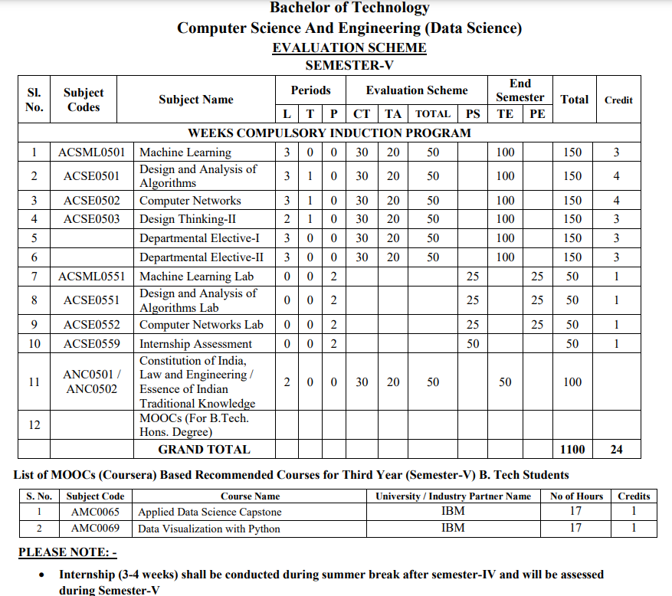
Evaluation Scheme

Slide 3
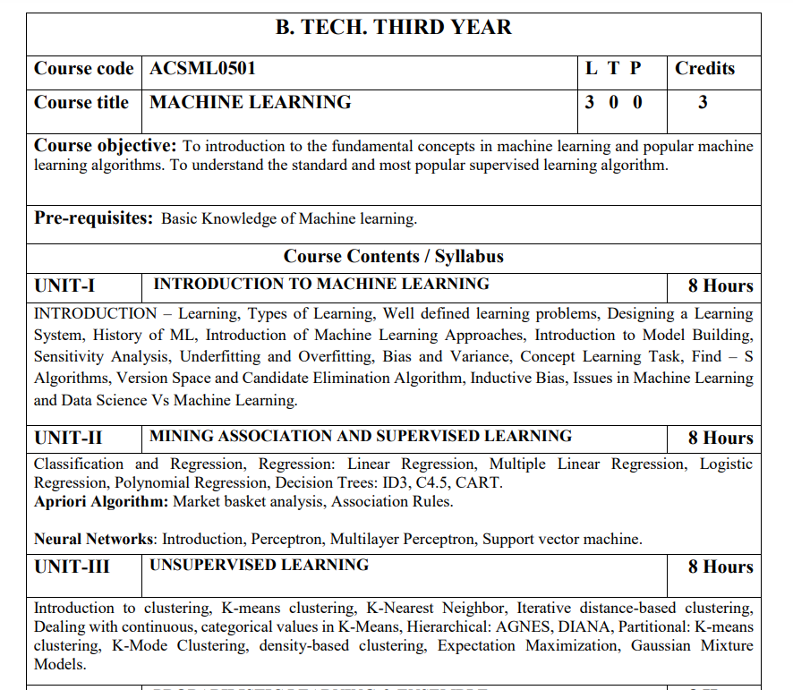
Subject Syllabus

Slide 4
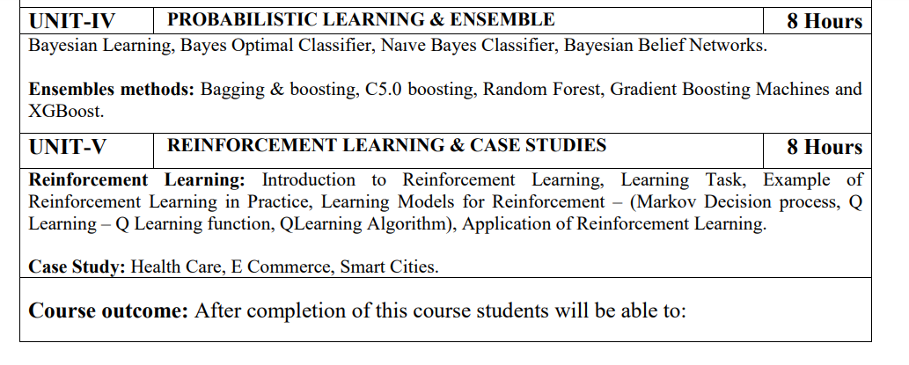
Subject Syllabus

Slide 5
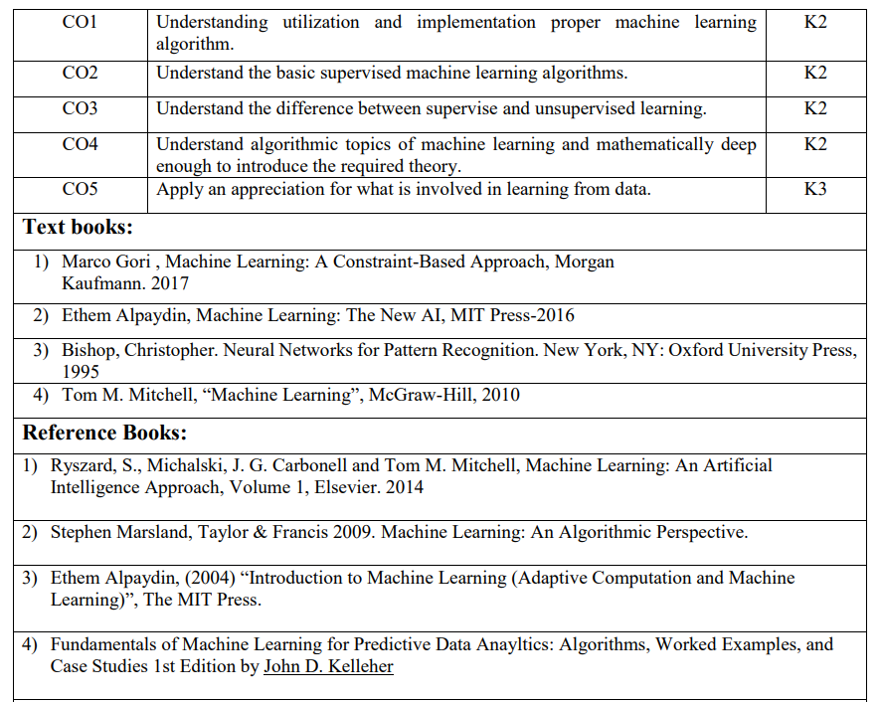
Text Books

Slide 6
Branch Wise Applications

Slide 7
Branch Wise Applications
To introduce students to the basic concepts of Machine Learning.
To develop skills of implementing machine learning for solving practical problems.
To gain experience of doing independent study and research related to Machine Learning

Slide 8
Course Outcome
At the end of the semester, student will be able to:
Course Outcomes (CO) | CO Description | Blooms’ Taxonomy
CO1 | Understanding utilization and implementation proper machine learning algorithm. | K2
CO2 | Understand the basic supervised machine learning algorithms. | K2
CO3 | Understand the difference between supervise and unsupervised learning. | K2
CO4 | Understand algorithmic topics of machine learning and mathematically deep enough to introduce the required theory. | K2
CO5 | Apply an appreciation for what is involved in learning from data. | K3

Slide 9
Program Outcome
1. Engineering knowledge:
2. Problem analysis:
3. Design/development of solutions:
4. Conduct investigations of complex problems:
5. Modern tool usage:
6. The engineer and society:
7. Environment and sustainability:
8. Ethics:
9. Individual and team work:
10. Communication:
11. Project management and finance:
12. Life-long learning

Slide 10
CO-PO and PSO Mapping
Correlation Matrix of CO with PO
CO.K | PO1 | PO2 | PO3 | PO4 | PO5 | PO6 | PO7 | PO8 | PO9 | PO10 | PO11 | PO12
ACSML0601.1 | 3 | 2 | 2 | 1 | 2 | 2 | - | - | - | 1 | - | -
ACSML0601.2 | 3 | 2 | 2 | 3 | 2 | 2 | 1 | - | 2 | 1 | 1 | 2
ACSML0601.3 | 2 | 2 | 2 | 2 | 2 | 2 | 2 | 1 | 1 | - | 1 | 3
ACSML0601.4 | 3 | 3 | 1 | 3 | 1 | 1 | 2 | - | 2 | 1 | 1 | 2
ACSML0601.5 | 3 | 2 | 1 | 2 | 1 | 2 | 1 | 1 | 2 | 1 | 1 | 1
AVG | 2.8 | 2.2 | 1.6 | 2.2 | 1.6 | 1.8 | 1.2 | 0.4 | 1.4 | 0.8 | 0.8 | 1.6

Slide 11
Program Specific Outcomes
PSO1-Apply Artificial Intelligence and its applications to design intelligent systems for the betterment of society.
PSO2-Develop AI-based innovative solutions demonstrating research, entrepreneurship, professional ethics, and communication skills.
PSO3-Demonstrate competency in AI by working in a team and engaging in life-long learning.
11

Slide 12
CO-PO and PSO Mapping
Matrix of CO/PSO:
 | PSO1 | PSO2 | PSO3
ACSML0601.1 | 3 | 2 | 3
ACSML0601.2 | 3 | 2 | 2
ACSML0601.3 | 3 | 2 | 3
ACSML0601.4 | 2 | 1 | 1
ACSML0601.5 | 2 | 2 | 1
AVG | 2.6 | 1.8 | 2

Slide 13
Program Educational Objectives
PEO1-Engage in successful professional practices in the area of Artificial Intelligence and pursue higher education and research.
PEO2-Demonstrate effective leadership and communicate as an individual and as a team in the workspace and society.
PEO3-Pursue life-long learning in developing AI-based innovative solutions for the betterment of society.

Slide 14
Result Analysis
ML Result of 2020-21: 89.39%
Average Marks: 46.05

Slide 15
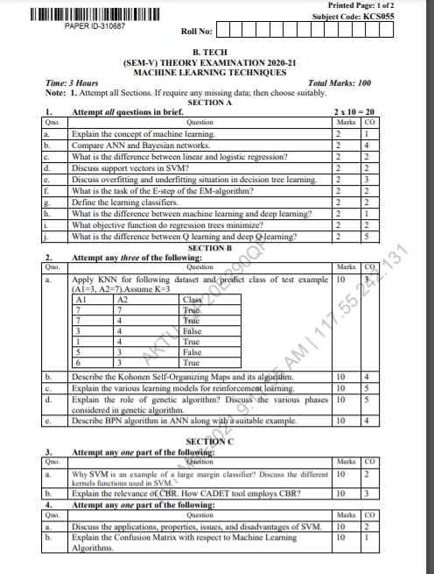
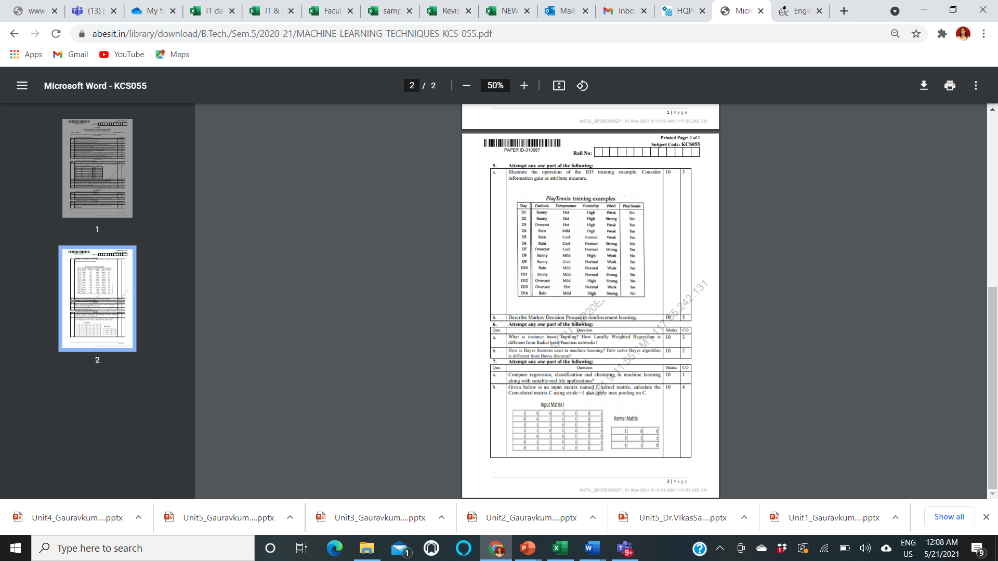
End Semester Question Paper Template

Slide 16
Prerequisite
Prerequisites:
Statistics.
Linear Algebra.
Calculus.
Probability.
Programming Languages.

Slide 17
Brief Introduction to Subject
https://www.youtube.com/watch?v=PPLop4L2eGk&list=PLLssT5z_DsK-h9vYZkQkYNWcItqhlRJLN

Slide 18
Topic Mapping with Course Outcome
Topics | Course outcome
Learning, Types of Learning, Well defined learning problems. Designing a Learning System. Concept Learning Introduction of Machine Learning Approaches –Issues in Machine Learning. Data Science Vs Machine Learning; | CO1 CO1 CO1 CO1 CO1

Slide 19
Lecture Plan

Slide 20
Lecture Plan

Slide 21
Lecture Plan

Slide 22
Lecture Plan

Slide 23
Lecture Plan

Slide 24
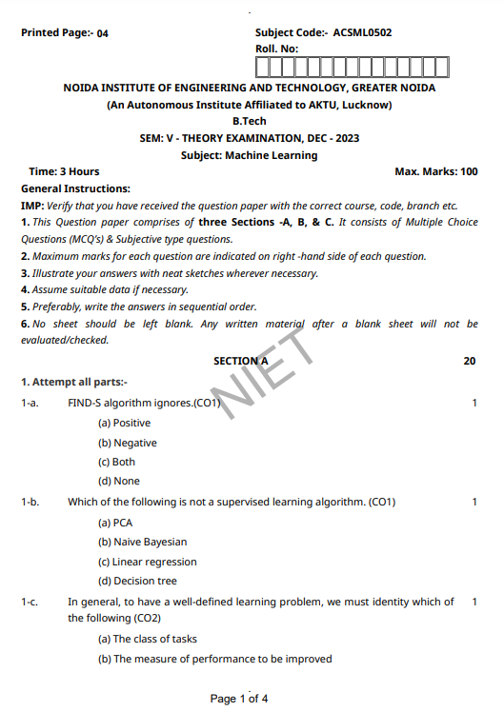
Old Question Papers

Slide 25
Brief Introduction to Subject
https://www.youtube.com/watch?v=PPLop4L2eGk&list=PLLssT5z_DsK-h9vYZkQkYNWcItqhlRJLN

Slide 26

Unit 3 Content:
Introduction to clustering, K-means clustering,
K-Nearest Neighbor,) Iterative distance-based clustering,
Dealing with continuous, categorical values in K-Means,
Hierarchical: AGNES, DIANA, Partitional: K-means clustering, K-Mode Clustering,
density-based clustering,
Expectation Maximization, Gaussian Mixture Models.

Slide 27
Unit Objective
The objective of the Unit 3
1. To understand the basics of Unsupervised learning,
2. A clear concept of carious clustering algorithms.

Slide 28
Topic Objective
Student will be able to understand
Clustering
K- Nearest Neighbor
K – Mean Clustering
Hierarchical Clustering

Slide 29

K-Nearest Neighbor(KNN) Algorithm for Machine Learning
(CO1,2,3,5)
K- Nearest Neighbor:
K-Nearest Neighbor is one of the simplest Machine Learning algorithms based on Supervised Learning technique.
K-NN algorithm assumes the similarity between the new case/data and available cases and put the new case into the category that is most similar to the available categories.
K-NN algorithm stores all the available data and classifies a new data point based on the similarity. This means when new data appears then it can be easily classified into a well suite category by using K- NN algorithm.
K-NN algorithm can be used for Regression as well as for Classification but mostly it is used for the Classification problems.

Slide 30
Instance-Based Learning(CO1,2,3,5)
K-NN is a non-parametric algorithm, which means it does not make any assumption on underlying data.
It is also called a lazy learner algorithm because it does not learn from the training set immediately instead it stores the dataset and at the time of classification, it performs an action on the dataset.
KNN algorithm at the training phase just stores the dataset and when it gets new data, then it classifies that data into a category that is much similar to the new data.
Example: Suppose, we have an image of a creature that looks similar to cat and dog, but we want to know either it is a cat or dog.
So for this identification, we can use the KNN algorithm, as it works on a similarity measure. Our KNN model will find the similar features of the new data set to the cats and dogs images and based on the most similar features it will put it in either cat or dog category.

Slide 31
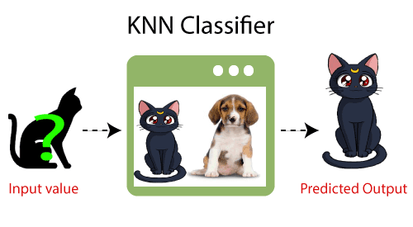
Instance-Based Learning(CO1,2,3,5)

Slide 32
Instance-Based Learning(CO1,2,3,5)
Why do we need a K-NN Algorithm?
Suppose there are two categories, i.e., Category A and Category B, and we have a new data point x1, so this data point will lie in which of these categories.
To solve this type of problem, we need a K-NN algorithm.
With the help of K-NN, we can easily identify the category or class of a particular dataset.
Consider the below diagram:

Slide 33
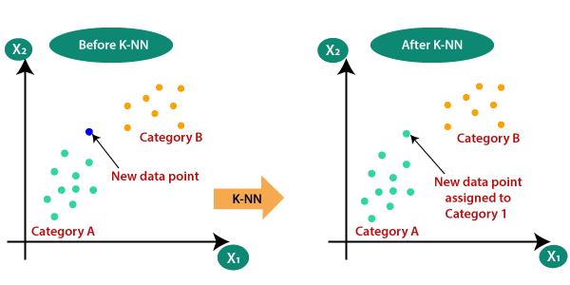
Instance-Based Learning(CO1,2,3,5)

Slide 34
Instance-Based Learning(CO1,2,3,5)
The K-NN working can be explained on the basis of the below algorithm:
Step-1: Select the number K of the neighbors
Step-2: Calculate the Euclidean distance of K number of neighbors
Step-3: Take the K nearest neighbors as per the calculated Euclidean distance.
Step-4: Among these k neighbors, count the number of the data points in each category.
Step-5: Assign the new data points to that category for which the number of the neighbor is maximum.
Step-6: Our model is ready.

Slide 35
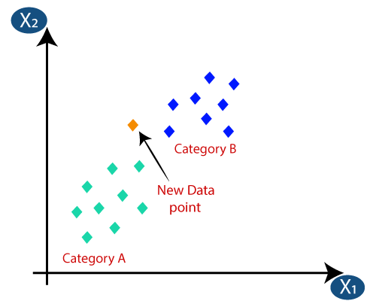
Instance-Based Learning(CO1,2,3,5)
Firstly, we will choose the number of neighbors, so we will choose the k=5.
Next, we will calculate the Euclidean distance between the data points.
The Euclidean distance is the distance between two points, which we have already studied in geometry.
It can be calculated as:

Slide 36
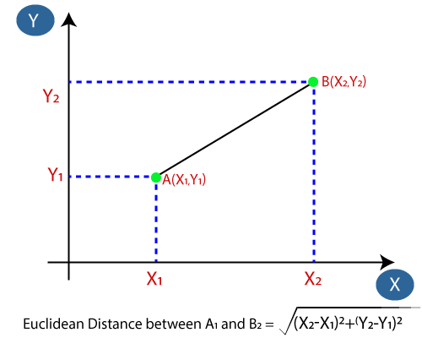
Instance-Based Learning(CO1,2,3,5)

Slide 37
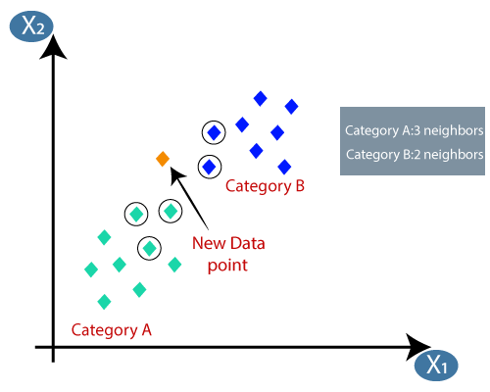
Instance-Based Learning(CO1,2,3,5)
By calculating the Euclidean distance we got the nearest neighbors, as three nearest neighbors in category A and two nearest neighbors in category B.
Consider the below image:
As we can see the 3 nearest neighbors are from category A, hence this new data point must belong to category A.

Slide 38
Instance-Based Learning(CO1,2,3,5)
How to select the value of K in the K-NN Algorithm?
Below are some points to remember while selecting the value of K in the K-NN algorithm:
There is no particular way to determine the best value for "K", so we need to try some values to find the best out of them. The most preferred value for K is 5.
A very low value for K such as K=1 or K=2, can be noisy and lead to the effects of outliers in the model.
Large values for K are good, but it may find some difficulties.

Slide 39
Instance-Based Learning(CO1,2,3,5)

Slide 40
Instance-Based Learning(CO1,2,3,5)

Slide 41
Instance-Based Learning(CO1,2,3,5)

Slide 42
Instance-Based Learning(CO1,2,3,5)

Slide 43
K-Means Clustering Algorithm (CO3 )
K-Means Clustering is an unsupervised learning algorithm that is used to solve the clustering problems in machine learning or data science.
In this topic, we will learn what is K-means clustering algorithm, how the algorithm works, along with the Python implementation of k-means clustering.

Slide 44
K-Means Clustering Algorithm (CO3 )
K-Means Clustering is an Unsupervised Learning algorithm, which groups the unlabeled dataset into different clusters. Here K defines the number of pre-defined clusters that need to be created in the process, as if K=2, there will be two clusters, and for K=3, there will be three clusters, and so on.
It allows us to cluster the data into different groups and a convenient way to discover the categories of groups in the unlabeled dataset on its own without the need for any training.
It is a centroid-based algorithm, where each cluster is associated with a centroid. The main aim of this algorithm is to minimize the sum of distances between the data point and their corresponding clusters.

Slide 45
K-Means Clustering Algorithm (CO3 )
The algorithm takes the unlabeled dataset as input, divides the dataset into k-number of clusters, and repeats the process until it does not find the best clusters. The value of k should be predetermined in this algorithm.
The k-means clustering algorithm mainly performs two tasks:
Determines the best value for K center points or centroids by an iterative process.
Assigns each data point to its closest k-center. Those data points which are near to the particular k-center, create a cluster.
Hence each cluster has datapoints with some commonalities, and it is away from other clusters.

Slide 46
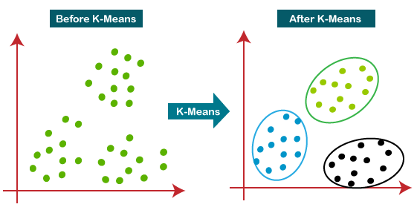
K-Means Clustering Algorithm (CO3 )

Slide 47
K-Means Clustering Algorithm (CO3 )
How does the K-Means Algorithm Work?
The working of the K-Means algorithm is explained in the below steps:
Step-1: Select the number K to decide the number of clusters.
Step-2: Select random K points or centroids. (It can be other from the input dataset).
Step-3: Assign each data point to their closest centroid, which will form the predefined K clusters.

Slide 48
K-Means Clustering Algorithm (CO3 )
Step-4: Calculate the variance and place a new centroid of each cluster.
Step-5: Repeat the third steps, which means reassign each datapoint to the new closest centroid of each cluster.
Step-6: If any reassignment occurs, then go to step-4 else go to FINISH.
Step-7: The model is ready.

Slide 49
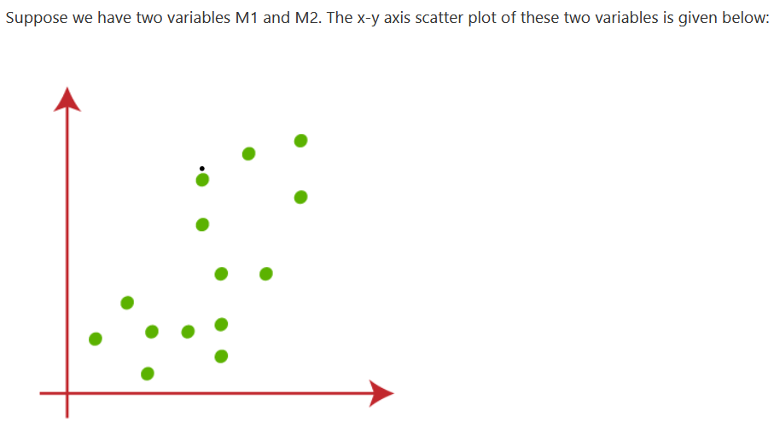
K-Means Clustering Algorithm (CO3 )

Slide 50
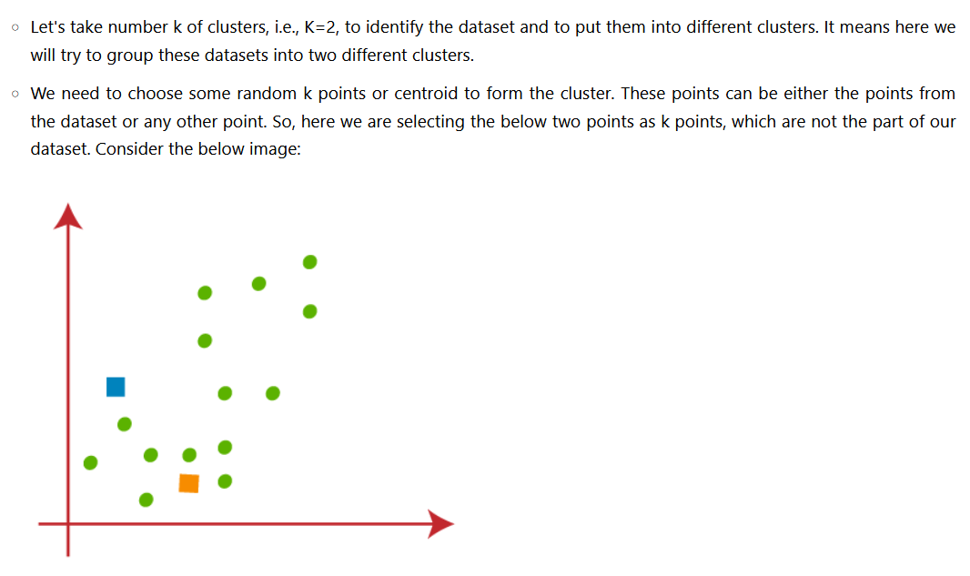
K-Means Clustering Algorithm (CO3 )

Slide 51
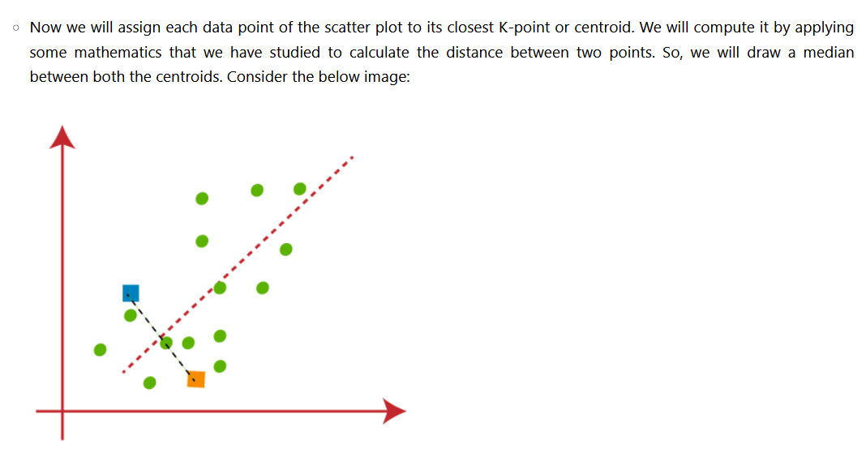
K-Means Clustering Algorithm (CO3 )

Slide 52
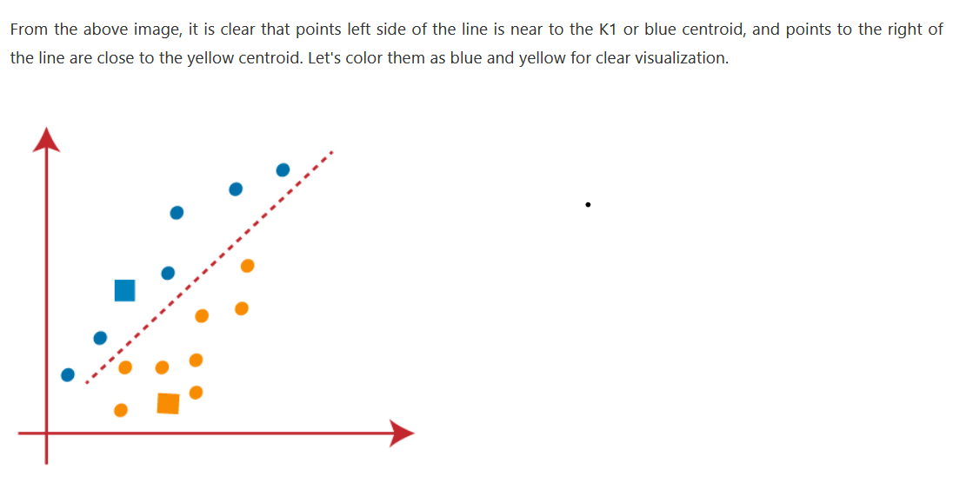
K-Means Clustering Algorithm (CO3 )

Slide 53
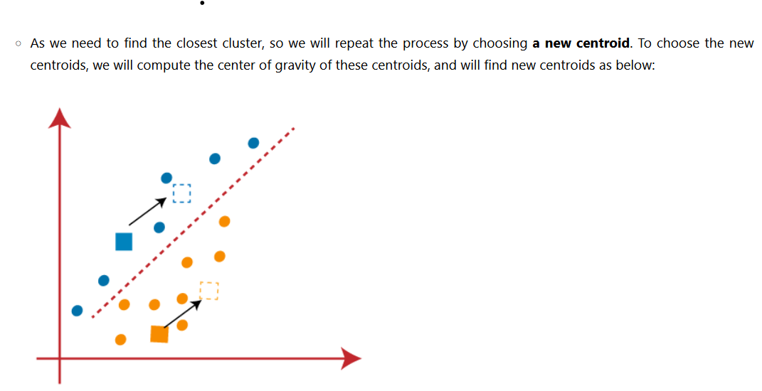
K-Means Clustering Algorithm (CO3 )

Slide 54
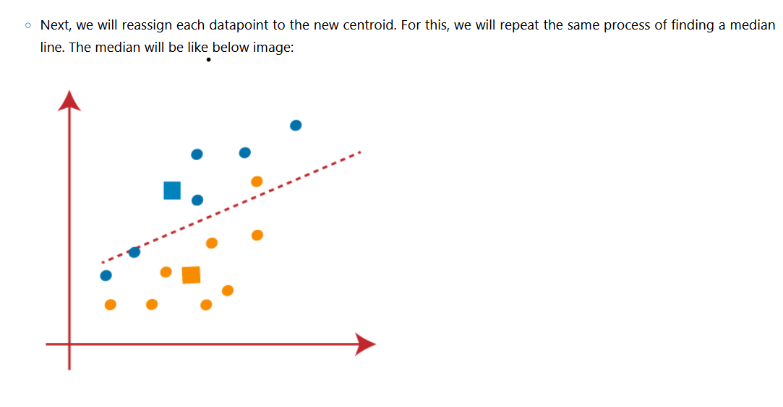
K-Means Clustering Algorithm (CO3 )

Slide 55
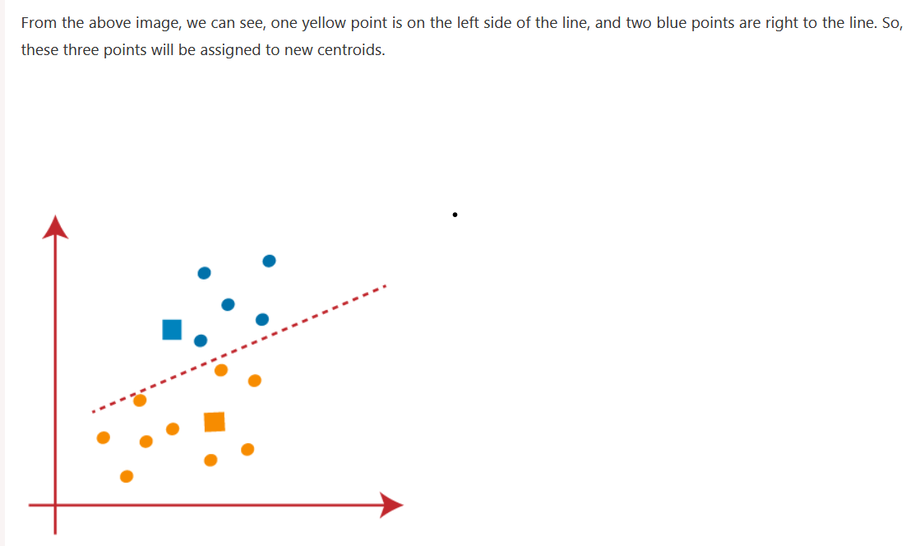
K-Means Clustering Algorithm (CO3 )

Slide 56
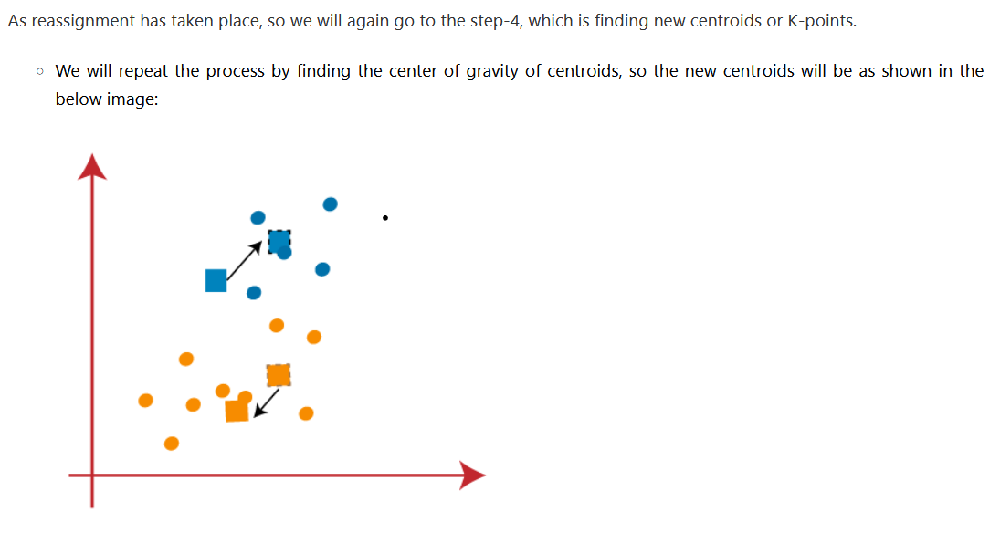
K-Means Clustering Algorithm (CO3 )

Slide 57
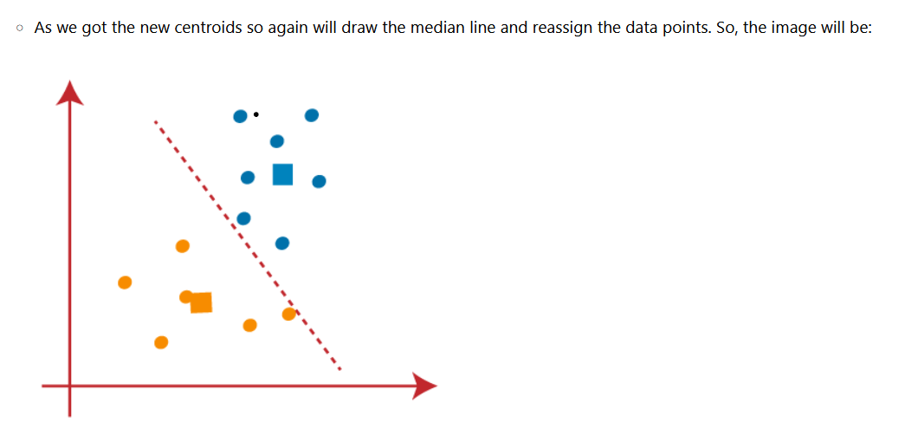
K-Means Clustering Algorithm (CO3 )

Slide 58
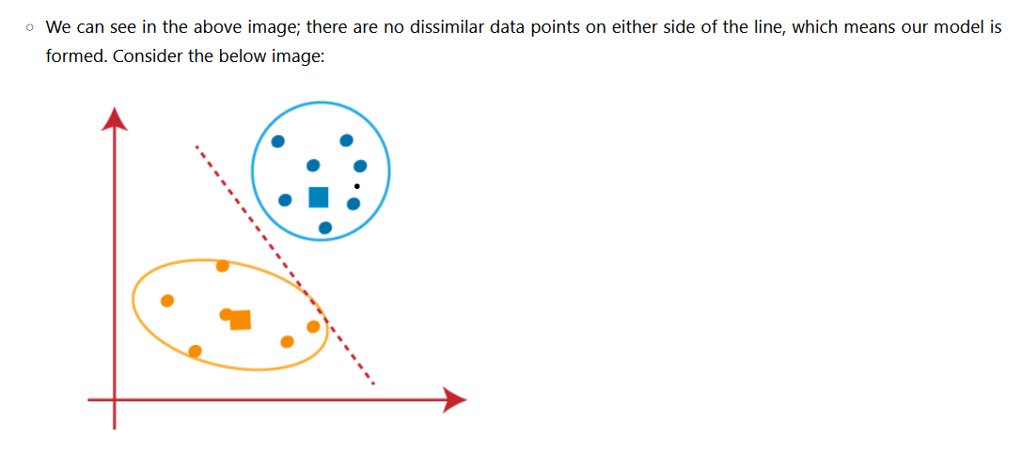
K-Means Clustering Algorithm (CO3 )

Slide 59
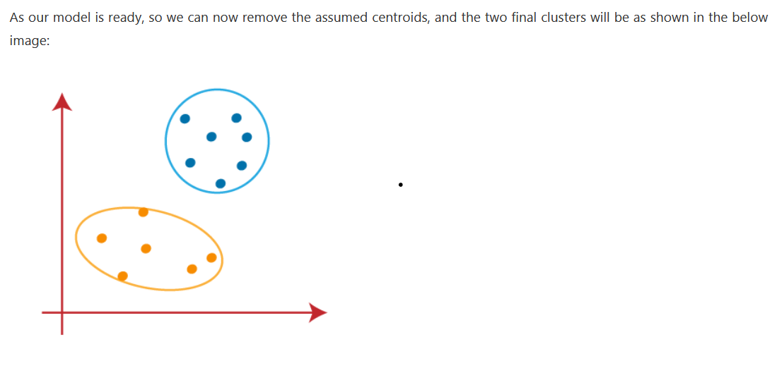
K-Means Clustering Algorithm (CO3 )

Slide 60
K-Means Clustering Algorithm (CO3 )
How to choose the value of "K number of clusters" in K-means Clustering?
The performance of the K-means clustering algorithm depends upon highly efficient clusters that it forms. But choosing the optimal number of clusters is a big task. There are some different ways to find the optimal number of clusters, but here we are discussing the most appropriate method to find the number of clusters or value of K. The method is given below:

Slide 61
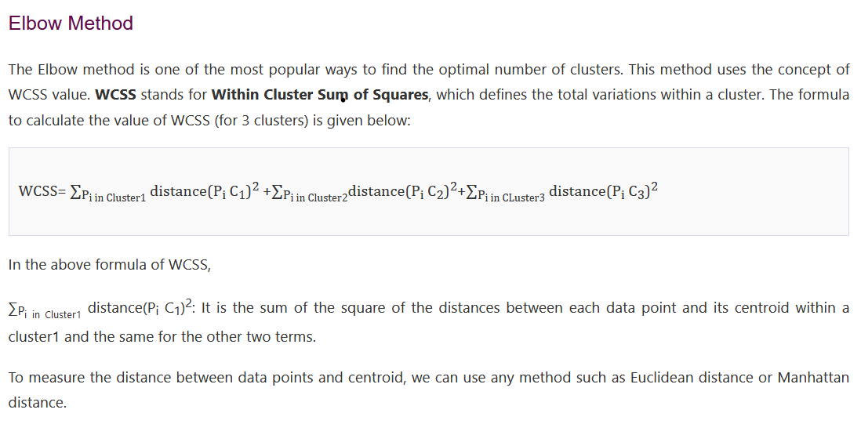
K-Means Clustering Algorithm (CO3 )

Slide 62
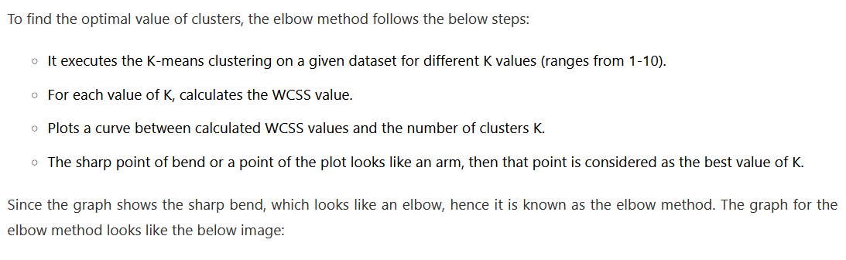
K-Means Clustering Algorithm (CO3 )

Slide 63
Hierarchical Clustering Algorithm (CO3 )
Hierarchical Clustering
A clustering algorithm that groups similar objects in the form of clusters. The scope for a detailed understanding of Hierarchical clustering in this blog is not feasible as it is a vast topic.
By hitting the above link you will understand in and out of hierarchical clusters concerning their formation, the role of density and distances in hierarchical clustering with visuals diagrams. What we will focus today is on DIANA and AGNES hierarchical clustering.

Slide 64
Hierarchical Clustering Algorithm (CO3 )
DIANA Hierarchical Clustering
DIANA is also known as Divisie Analysis clustering algorithm. It is the top-down approach form of hierarchical clustering where all data points are initially assigned a single cluster. Further, the clusters are split into two least similar clusters. This is done recursively until clusters groups are formed which are distinct to each other.

Slide 65
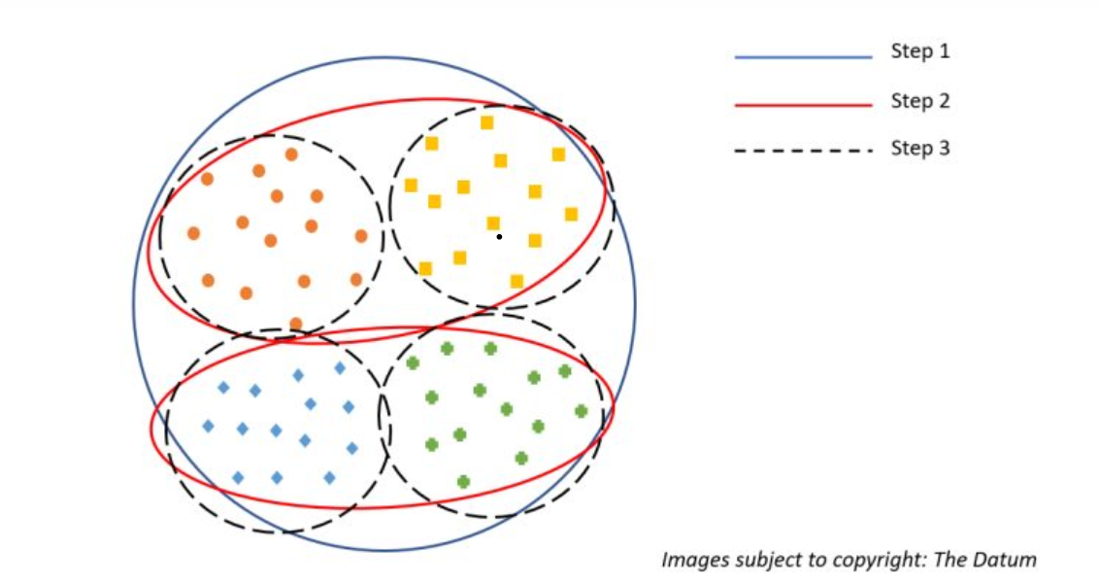
Hierarchical Clustering Algorithm (CO3 )

Slide 66
Hierarchical Clustering Algorithm (CO3 )
Notional representation of DIANA
To better understand consider the above figure:
In step 1 that is the blue outline circle can be thought of as all the points are assigned a single cluster. Moving forward it is divided into 2 red-colored clusters based on the distances/density of points. Now, we have two red-colored clusters In step 2.
Lastly, In step 3 the two red clusters are further divided into 2 black dotted each, again based on density and distances to give us final four clusters.
Since the points in the respective 4 clusters are very similar to each other and very different when compared to the other cluster groups they are not further divided. Thus, this is how we get DIANA clusters or top-down approached Hierarchical clusters.

Slide 67
Hierarchical Clustering Algorithm (CO3 )
AGNES Hierarchical Clustering
Agglomerative Nesting hierarchical clustering algorithm is exactly opposite of the DIANA we just saw above. It is an inside-out or bottoms-up approach. Here every data point is assigned as a cluster initially if there are n data points n clusters will be formed initially.
In the next iteration, similar clusters are merged (again based on the density and distances), this continuous until similar points are clustered together and are distinct for other clusters.

Slide 68
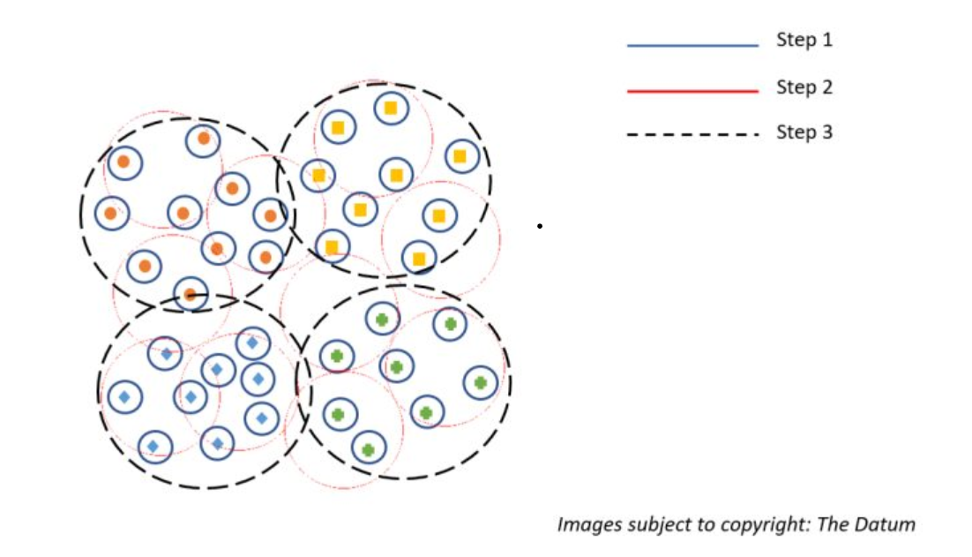
Hierarchical Clustering Algorithm (CO3 )

Slide 69
Hierarchical Clustering Algorithm (CO3 )
Notional representation of AGNES
As we can infer from the above representation for AGNES in step one all the data points are assigned as clusters. In step two again depending upon the density and distances the points are clubbed into a cluster.
Lastly, in step 3 all the similar points depending upon density and distances are clustered together which are distinct to other clusters thus forming our final clusters.

Slide 70
Density-based clustering (CO3 )
What is Density-based clustering?
Density-Based Clustering refers to one of the most popular unsupervised learning methodologies used in model building and machine learning algorithms.
The data points in the region separated by two clusters of low point density are considered as noise. The surroundings with a radius ε of a given object are known as the ε neighborhood of the object. If the ε neighborhood of the object comprises at least a minimum number, MinPts of objects, then it is called a core object.

Slide 71
Density-based clustering (CO3 )
Density-Based Clustering - Background
There are two different parameters to calculate the density-based clustering
E_{PS}: It is considered as the maximum radius of the neighborhood.
MinPts: MinPts refers to the minimum number of points in an Eps neighborhood of that point.
NEps (i) : { k belongs to D and dist (i,k) < = Eps}
Directly density reachable:
A point i is considered as the directly density reachable from a point k with respect to Eps, MinPts if
i belongs to NEps(k)
Core point condition:
NEps (k) >= MinPts

Slide 72
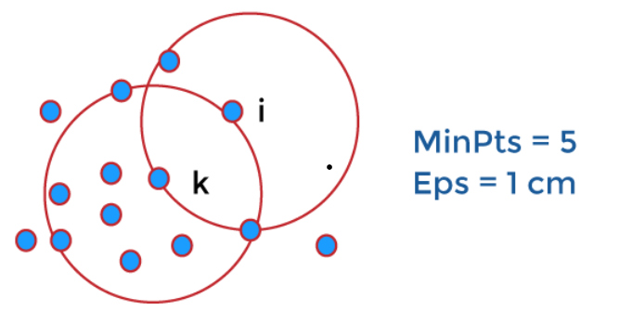
Density-based clustering (CO3 )

Slide 73
Density-based clustering (CO3 )
Density reachable:
A point denoted by i is a density reachable from a point j with respect to Eps, MinPts if there is a sequence chain of a point i1,…., in, i1 = j, pn = i such that i_{i} + 1 is directly density reachable from i_{i.}

Slide 74
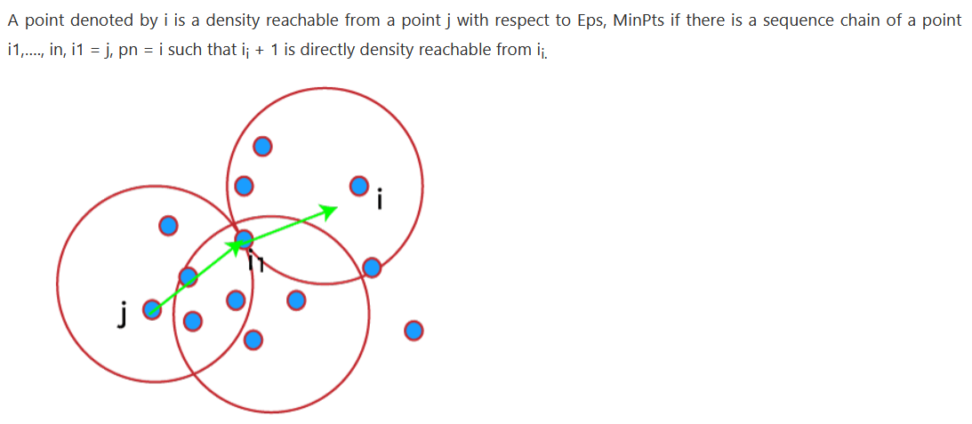
Density-based clustering (CO3 )

Slide 75
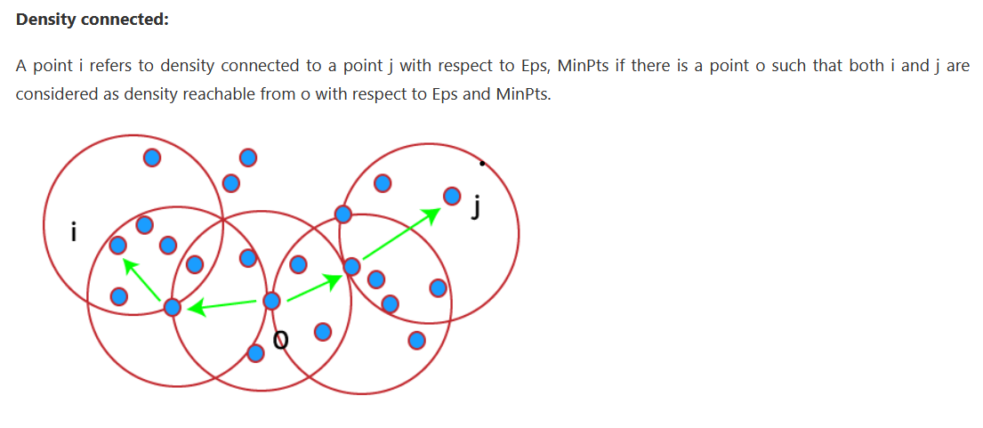
Density-based clustering (CO3 )

Slide 76
Density-based clustering (CO3 )
Working of Density-Based Clustering
Suppose a set of objects is denoted by D', we can say that an object I is directly density reachable form the object j only if it is located within the ε neighborhood of j, and j is a core object.
An object i is density reachable form the object j with respect to ε and MinPts in a given set of objects, D' only if there is a sequence of object chains point i1,…., in, i1 = j, pn = i such that i_{i} + 1 is directly density reachable from i_{i} with respect to ε and MinPts.
An object i is density connected object j with respect to ε and MinPts in a given set of objects, D' only if there is an object o belongs to D such that both point i and j are density reachable from o with respect to ε and MinPts.

Slide 77
Density-based clustering (CO3 )
Major Features of Density-Based Clustering
The primary features of Density-based clustering are given below.
It is a scan method.
It requires density parameters as a termination condition.
It is used to manage noise in data clusters.
Density-based clustering is used to identify clusters of arbitrary size.

Slide 78
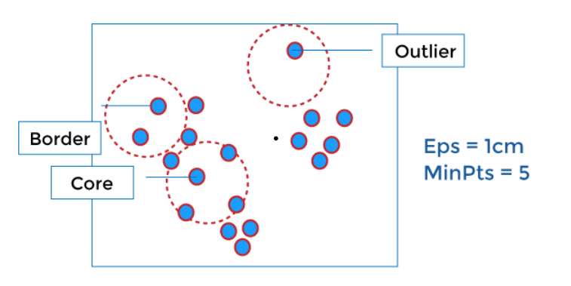
Density-based clustering (CO3 )
Density-Based Clustering Methods
DBSCAN
DBSCAN stands for Density-Based Spatial Clustering of Applications with Noise. It depends on a density-based notion of cluster. It also identifies clusters of arbitrary size in the spatial database with outliers.

Slide 79
Density-based clustering (CO3 )
OPTICS
OPTICS stands for Ordering Points To Identify the Clustering Structure. It gives a significant order of database with respect to its density-based clustering structure. The order of the cluster comprises information equivalent to the density-based clustering related to a long range of parameter settings. OPTICS methods are beneficial for both automatic and interactive cluster analysis, including determining an intrinsic clustering structure.
DENCLUE
Density-based clustering by Hinnebirg and Kiem. It enables a compact mathematical description of arbitrarily shaped clusters in high dimension state of data, and it is good for data sets with a huge amount of noise.

Slide 80
Assignment 1:
Q1: Define what is Clustering?
Q2: What is Similarity-based Clustering?
Q3: Give examples of using Clustering to solve real-life problems
Q4: What is Mean-Shift Clustering?
Q5: What are Self-Organizing Maps?
Q6: Why do you need to perform Significance Testing in Clustering?
Q7: What is the difference between a Multiclass problem and a Multilabel problem?
Q8: What is the Jaccard Index?
Q9: What is the difference between the two types of Hierarchical Clustering?
Q10: While performing K-Means Clustering, how do you determine the value of K?

Slide 81
Daily Quiz
What is K-means clustering?
How does K-means clustering work?
Why is K-means clustering important?
What is the core idea of K-means algorithm?
How does the K-means algorithm work?
What assumptions are used for K-means?
Is K-means supervised or unsupervised learning?

Slide 82
Glossary Questions
1._______is basically a type of unsupervised learning method
A) Unsupervised learning B) clustering C) semi supervised D) classification
ANSWER= B) clustering
2._______is the task of dividing the population or data points into a number of groups.
A) Unsupervised learning B) clustering C) semi supervised D) classification
ANSWER= B) clustering

Slide 83
Glossary Questions
3.Which of the following is not clustering method?
A) Density-Based B) Hierarchical Based C) Grid-based D) Project Based
ANSWER= D) Project Based
4.__________consider the clusters as the dense region having some similarity and
different from the lower dense region of the space
A) Density-Based B) Hierarchical Based C) Grid-based D) None of these
ANSWER= A) Density-Basedd

Slide 84
MCQ
1. Which of the following clustering type has characteristic shown in the below figure?
The clustering type has characteristic is hierarchical clustering groups data
a) Partitional
b) Hierarchical
c) Naive bayes
d) None of the mentioned
2. Point out the correct statement. a) The choice of an appropriate metric will influence the shape of the clusters b) Hierarchical clustering is also called HCA c) In general, the merges and splits are determined in a greedy manner d) All of the mentioned

Slide 85
MCQ
3. Which of the following is finally produced by Hierarchical Clustering? a) final estimate of cluster centroids b) tree showing how close things are to each other c) assignment of each point to clusters d) all of the mentioned
4. Which of the following is required by K-means clustering? a) defined distance metric b) number of clusters c) initial guess as to cluster centroids d) all of the mentioned

Slide 86
MCQ
5. Point out the wrong statement. a) k-means clustering is a method of vector quantization b) k-means clustering aims to partition n observations into k clusters c) k-nearest neighbor is same as k-means d) none of the mentioned
6. Which of the following combination is incorrect? a) Continuous – euclidean distance b) Continuous – correlation similarity c) Binary – manhattan distance d) None of the mentioned

Slide 87
MCQ
7. Hierarchical clustering should be primarily used for exploration. a) True b) False
8. Which of the following function is used for k-means clustering? a) k-means b) k-mean c) heatmap d) none of the mentioned

Slide 88
Faculty Video Links, Youtube & NPTEL Video Links and Online Courses Details
Youtube video-
https://www.youtube.com/watch?v=PDYfCkLY_DE
https://www.youtube.com/watch?v=ncOirIPHTOw
https://www.youtube.com/watch?v=cW03t3aZkmE

Slide 89
Weekly Assignment
Hierarchical clustering should be mainly used for exploration. (A). True (B). False
K-means clustering consists of a number of iterations and not deterministic. (A). True (B). False
Which is needed by K-means clustering? (A). defined distance metric (B). number of clusters (C). initial guess as to cluster centroids (D). all of these
Which function is used for k-means clustering? (A). k-means (B). k-mean (C). heatmap (D). none of the mentioned

Slide 90
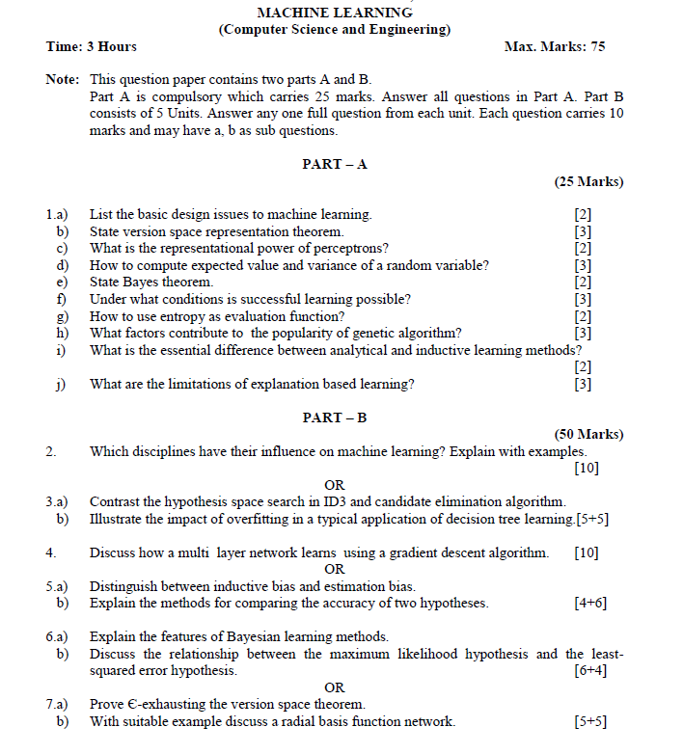
Old Question Papers

Slide 91
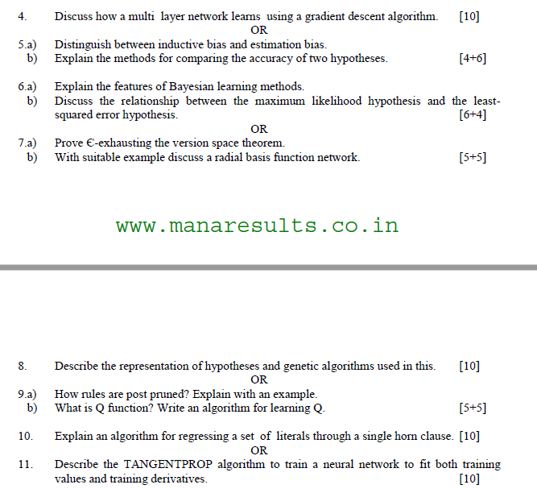
Old Question Papers

Slide 92
Old Question Papers

Slide 93
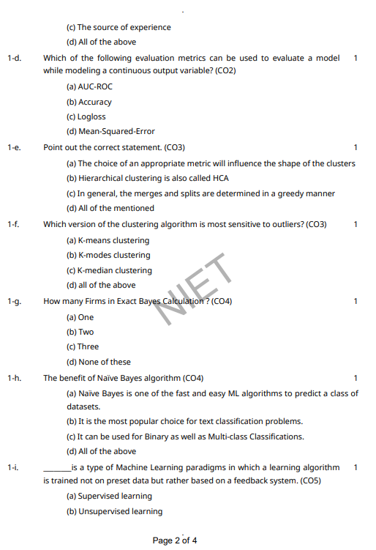
Old Question Papers

Slide 94
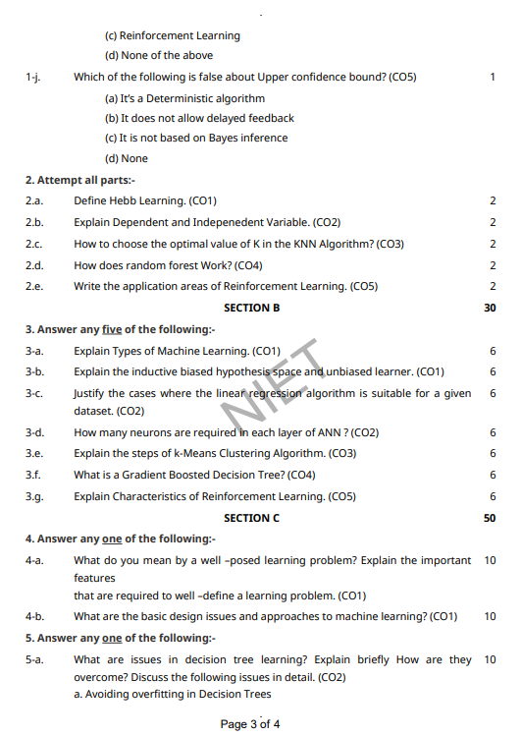
Old Question Papers

Slide 95
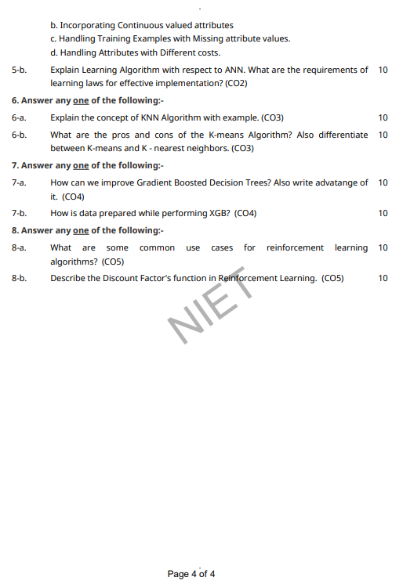
Old Question Papers

Slide 96
Expected Questions for University Exam
What is cluster analysis?
What is the goal of clustering analysis?
What is the difference between supervised learning and unsupervised learning?
What is Euclidean distance?
What is centroid?
What is the different between exploratory and confirmatory & explanatory analysis?
What is K-Means algorithm?
What are the pros and cons of the K-Means algorithm?

Slide 97
References
Text books:
1. Tom M. Mitchell, ―Machine Learning, McGraw-Hill Education (India) Private Limited, 2013.
2. Ethem Alpaydin, ―Introduction to Machine Learning (Adaptive Computation and Machine Learning), The MIT Press 2004.
3. Stephen Marsland, ―Machine Learning: An Algorithmic Perspective, CRC Press, 2009.
4. Bishop, C., Pattern Recognition and Machine Learning. Berlin: Springer-Verlag.

Slide 98
Recap of Unit
Clustering is one of the important methods for knowledge discovery and data mining applications. Spatial-temporal data is being generated in large amounts and needs to be analyzed.

